Slide 1
Group 1 Review of Group 12
Members of Group 12:
Rajeshwari Ravi
Naresh Kumar
Christopher Scheller
Their Project is inspired by TROLLO

Slide 2
Something interesting about their project.
About their project
It’s a program that creates boards, lists and cards to let teams work together to accomplish task.
It seems similar to the any.do you create list to keep track of all the task needed to be completed.1
They used a robust database.

Slide 3
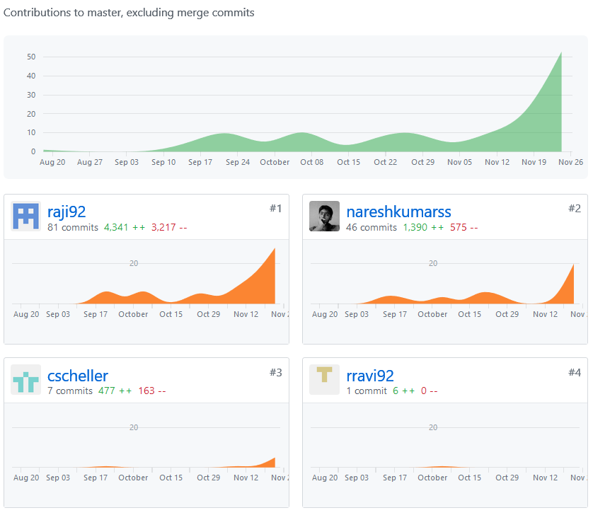
Graph of Their Combine Total Contribution to Master
Rajeshwari Ravi
Naresh Kumar
81 commits with 4341 ++
46 commits with 1390 ++
Christopher Scheller
7 commits with 477 ++

